Slide 1
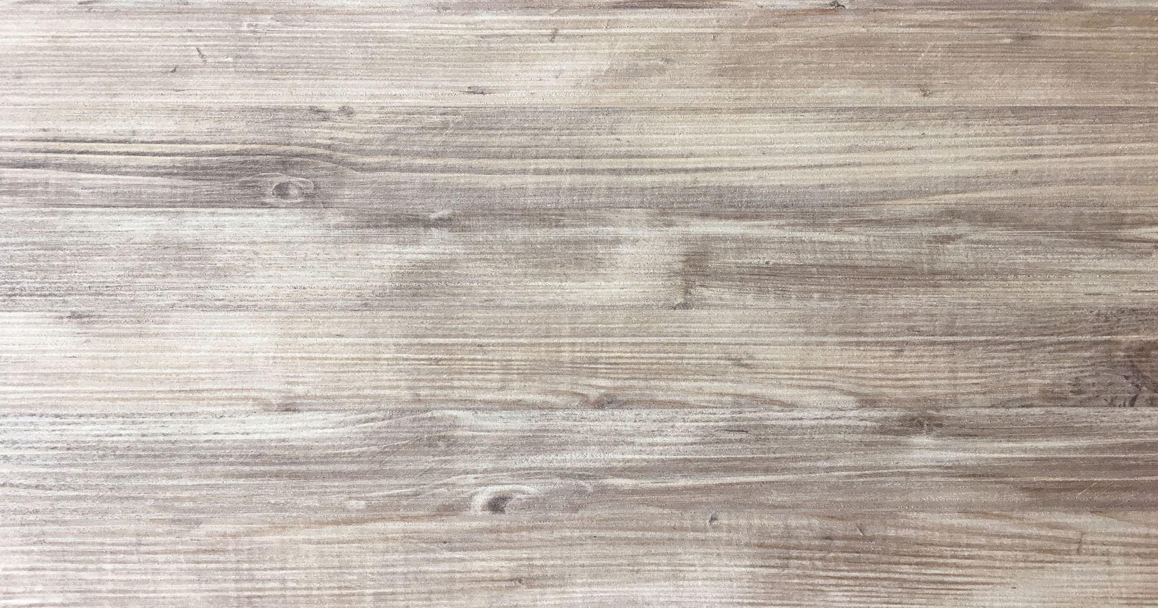
My Father and I: threw my eyes Sharktank Presentation 9th Grade
By Juan Ricardo Vela

Slide 2
What is my project about?
What I want to convey in my project is the different ways in which a son can connect in a special way with his father. In my case, this way of connection between my father and me, are motorcycles and extreme sports. I want to express that feeling, that goes beyond what this sport implies, I want to express how a lifetime surrounded by this environment, allowed me to develop a unique connection with my father, considering it even a tradition.
Through this project, I want to transmit memories, experiences, memories and feelings that touch all my childhood and that remain.

Slide 3
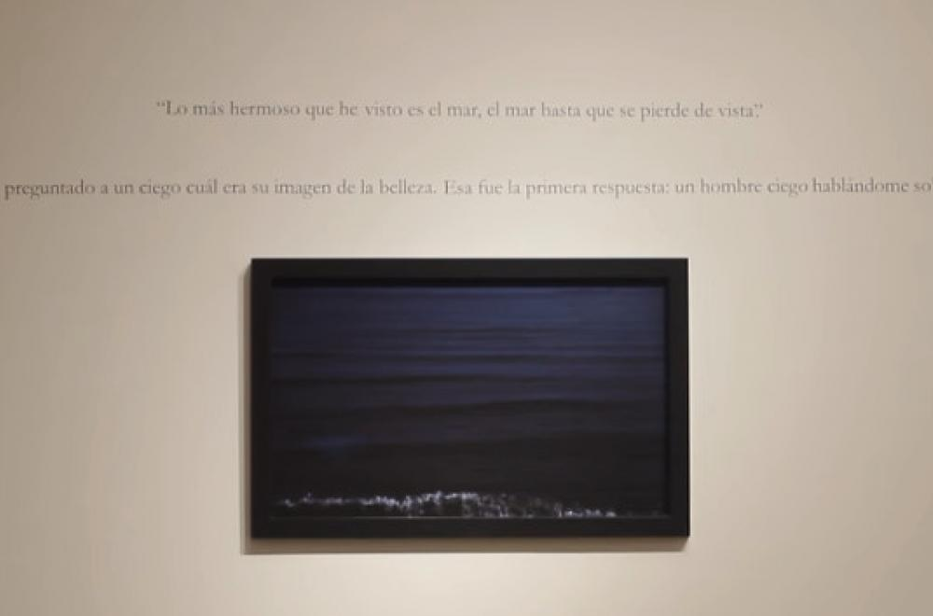
References for my work
SOPHIE CALLE
As a first reference, there is Sophie Calle. French artist, writer and photographer, she specializes in contemporary art. In her works she implements photos, writings, stories and even videos that complement the work and allow her to make it interactive.
What I am going to take from this reference, is the interactive part of the videos that complement the images of the work.
CHRISTIAN BOLTANSKI
As a second reference for my work, I will use the artist Christian Boltanski. He was born in 1944 in Paris, France. He specializes in conceptual art and contemporary art.
My reference to this author, focuses on photography and installation of these as a work of art.

Slide 4
Project idea
The idea for this project, implementing the references, is to create an interactive installation between the work and the viewer. This work will be composed by my archival object which is a motorcycle helmet that symbolizes both my passion for the sport and the relationship with my father that was generated through it.
Part of the work will be placed on a wall, including several images (mine and my father's related to motorcycles) from different years. The other part of the work will be on a shelf in front of the wall. On this shelf will be the helmet with Virtual glasses.
The spectator will be able to put on the helmet and watch the video playing on the glasses, which is my first motorcycle lesson with my dad.

Slide 5
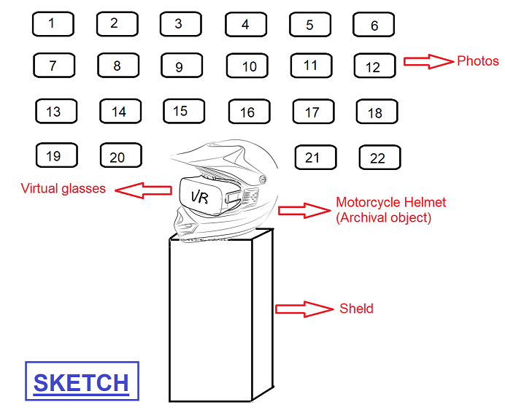
Sketch of the work

Slide 6
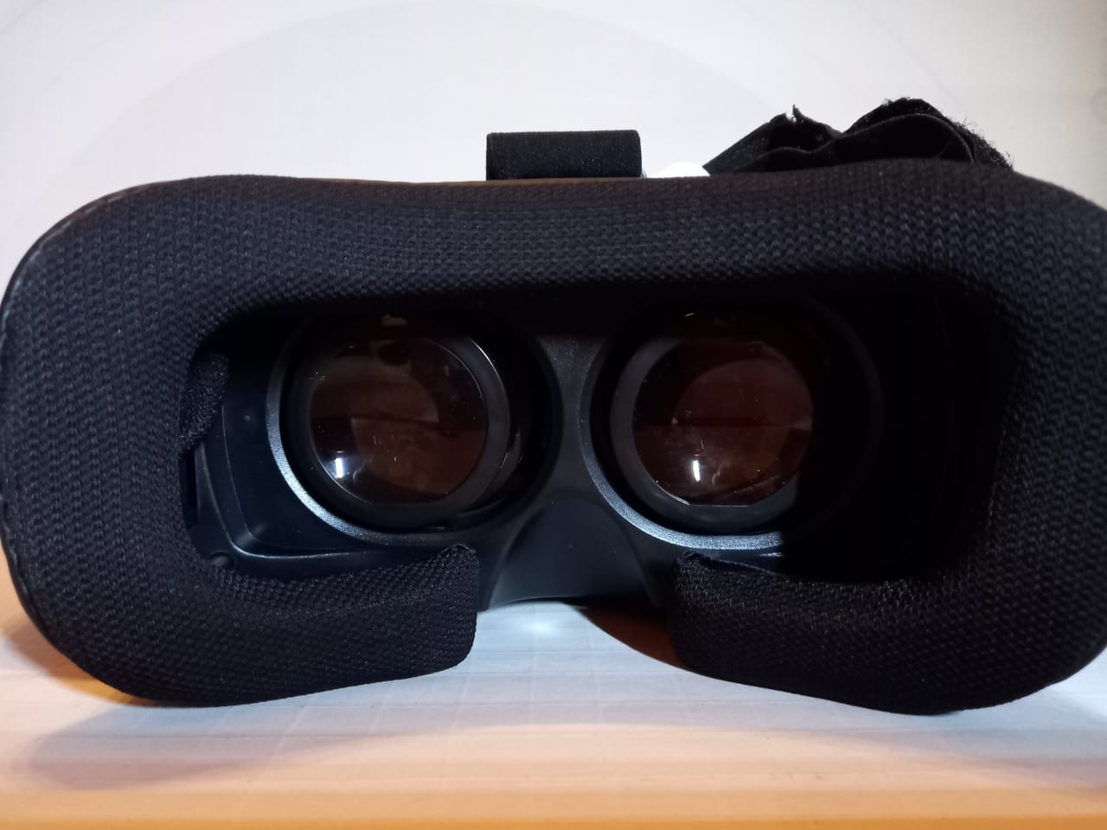
Sketch part 2

Slide 7
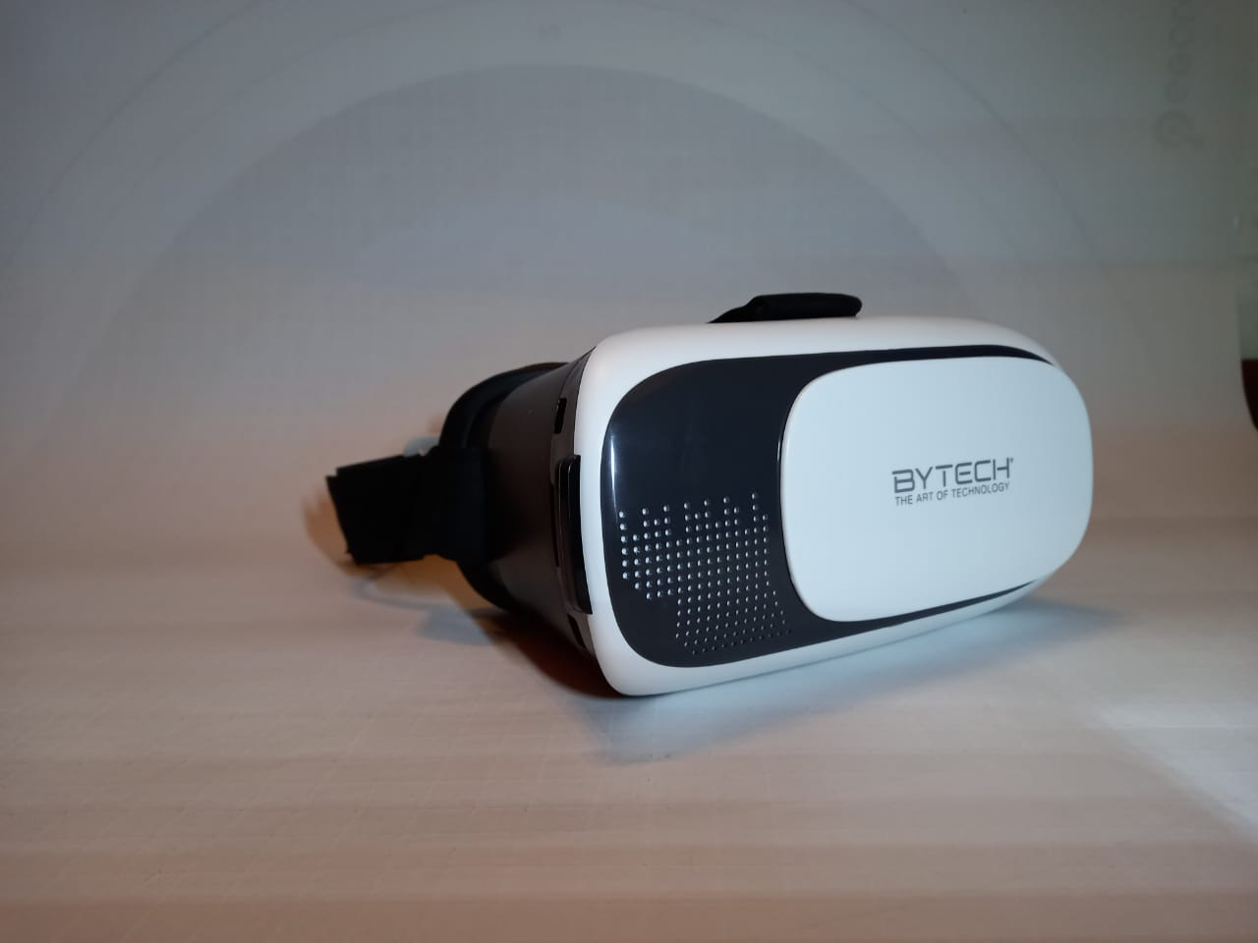
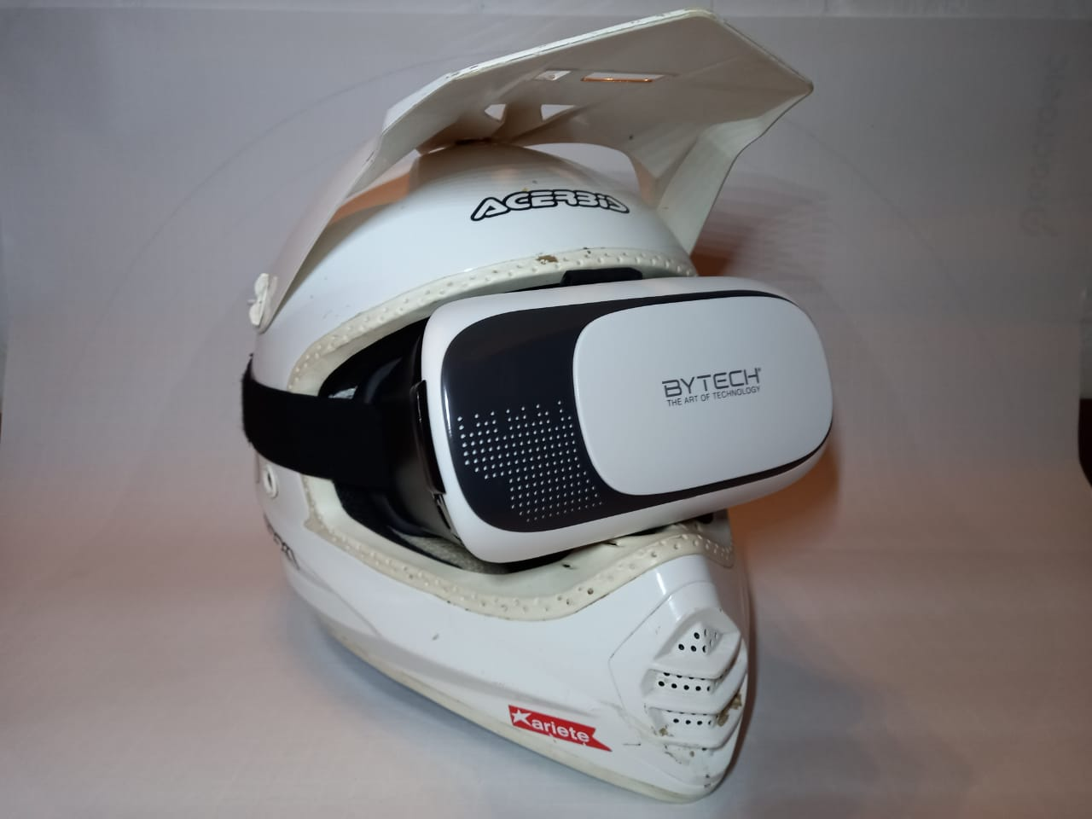
Materials and objects
My helmet (archival object)
Virtual glasses

Slide 8
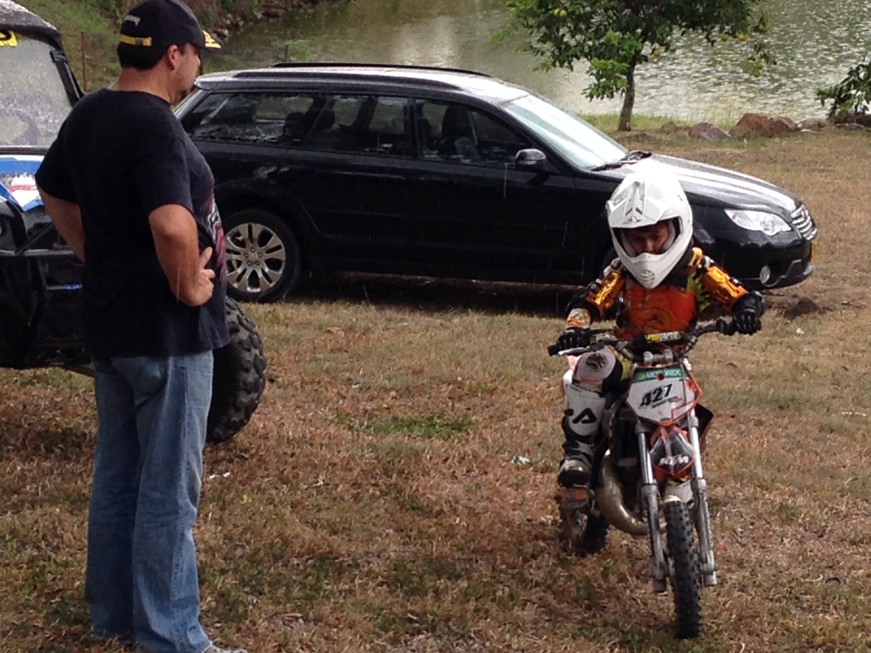
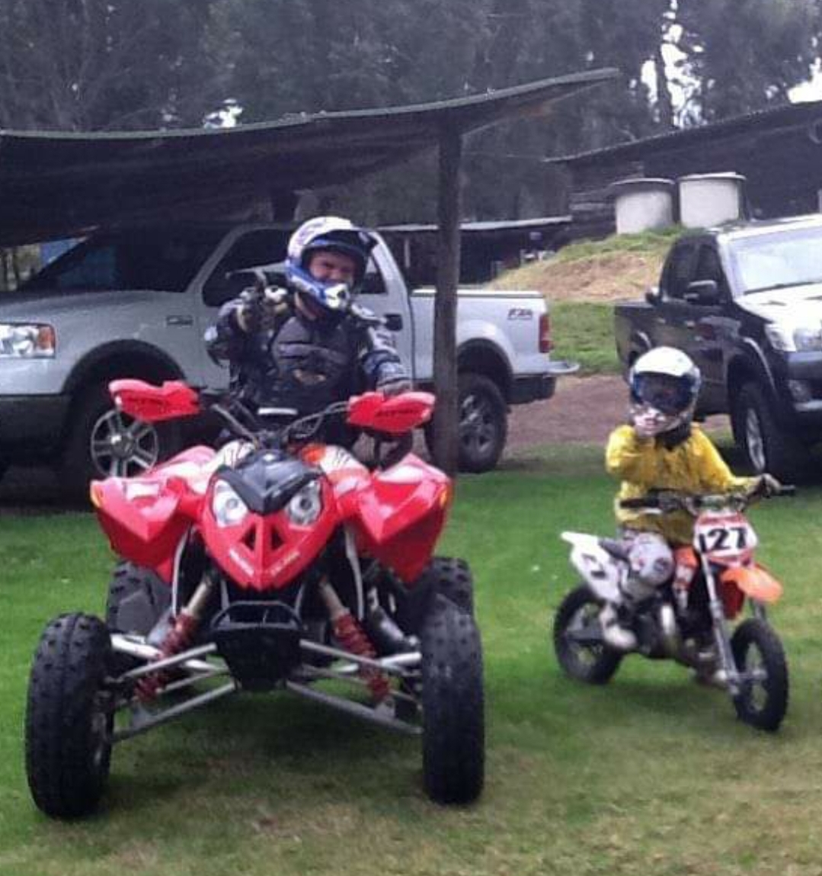
Materials and objects
The photos that will be located on the wall behind my helmet. Some examples:

Slide 9
Space for the project
The space proposed for the installation of my project is a white brick wall located in my living room.

Slide 10
Thank You!

